Slide 1
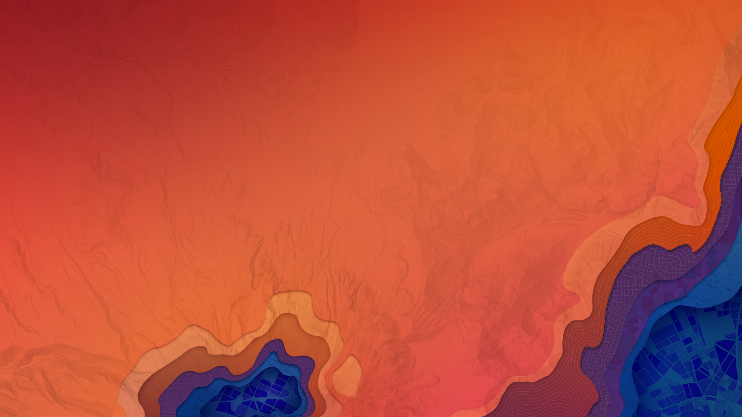


3D Visualization with the ArcGIS API for JavaScript
Kristian Ekenes
Javier Gutierrez

Slide 2
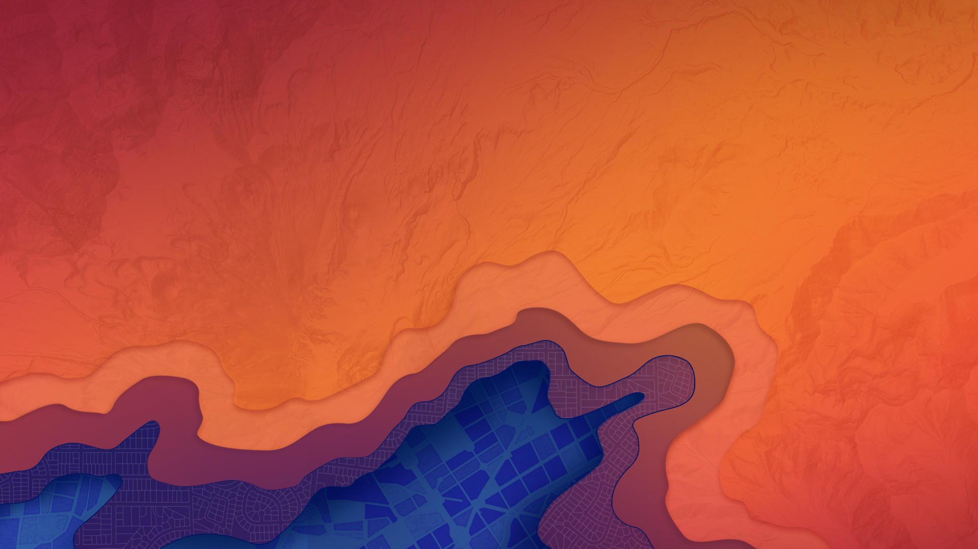
API Overview
Renderers, symbols, symbol layers…

Slide 3

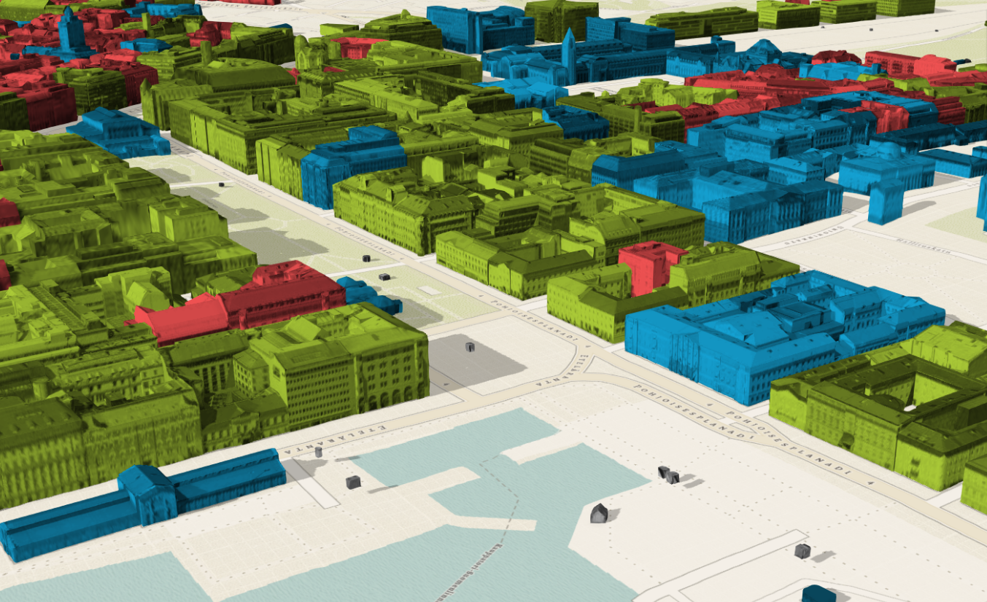
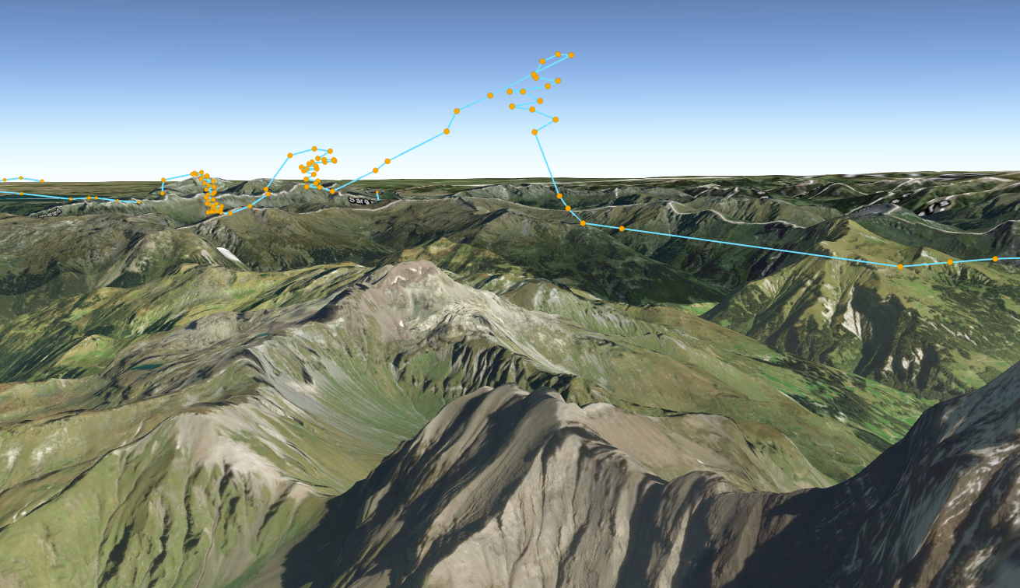
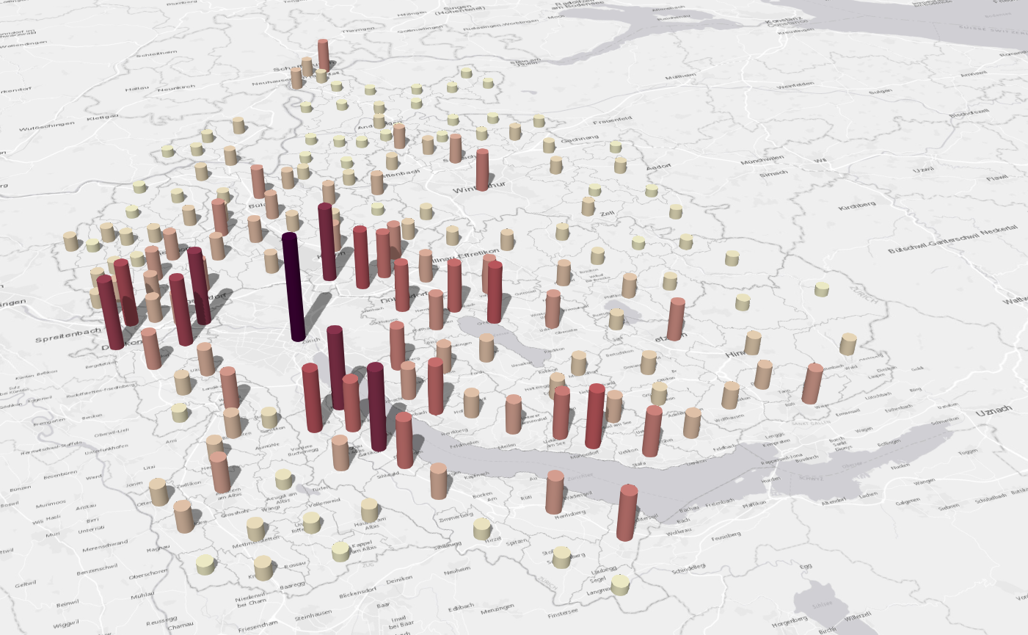
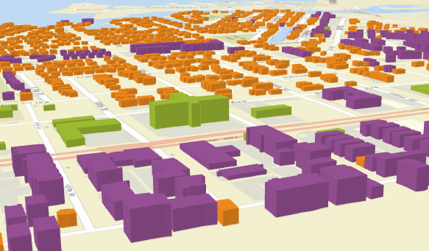
What can we visualize?
Location
Types
Data (numbers)
Combinations of the above

Slide 4
Data
FeatureLayer
MapImageLayer
SceneLayer
Includes 2D data sources
CSVLayer
PointCloudLayer
StreamLayer

Slide 5
Data-driven visualization
Renderers & Visual Variables
Field value(s) TOTAL_POP
Arcade expression Round( ($feature.BACHELOR + $feature.MASTER) / $feature.POP_25UP) );
JavaScript function function (graphic){ return graphic.attributes.POP_DENSITY; }

Slide 6
Symbols
And symbol layers

Slide 7
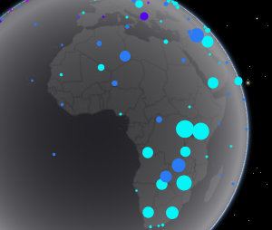
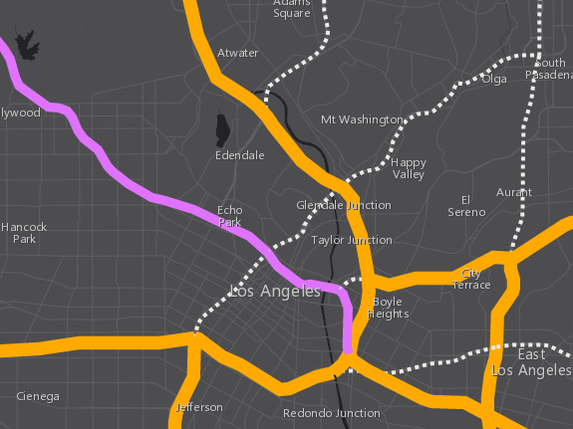
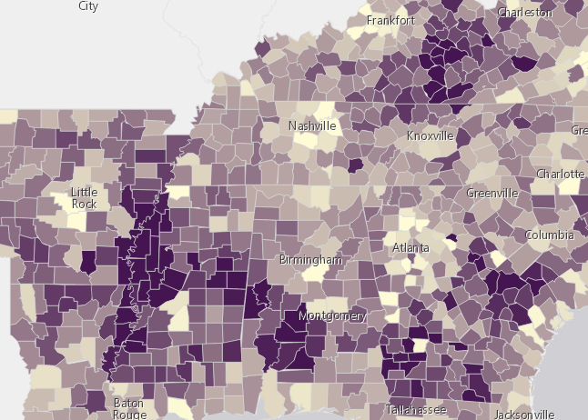
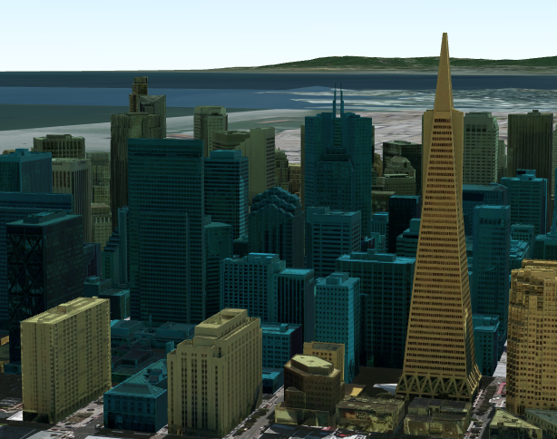
3D Symbols
based on geometry type
Points
Lines
Polygons
Mesh
PointSymbol3D
LineSymbol3D
PolygonSymbol3D
MeshSymbol3D

Slide 8
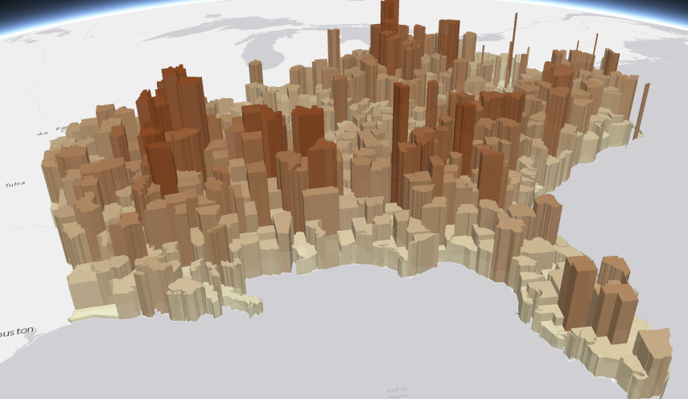
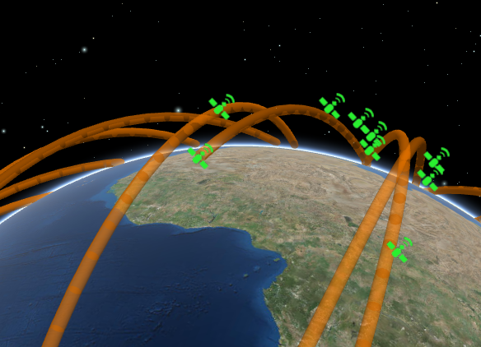
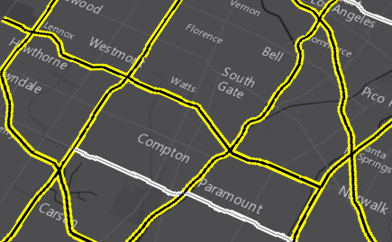
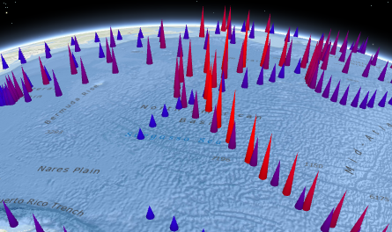
3D Symbols
Each must be composed of one or more symbol layers
Flat
Size is expressed in
screen units
Volumetric
Size is expressed in
real-world units
IconSymbol3DLayer
ExtrudeSymbol3DLayer
PathSymbol3DLayer
FillSymbol3DLayer
LineSymbol3DLayer
ObjectSymbol3DLayer

Slide 9
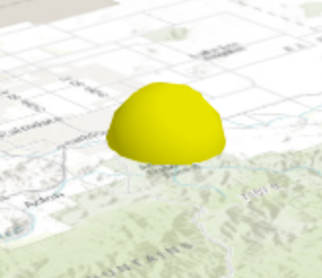
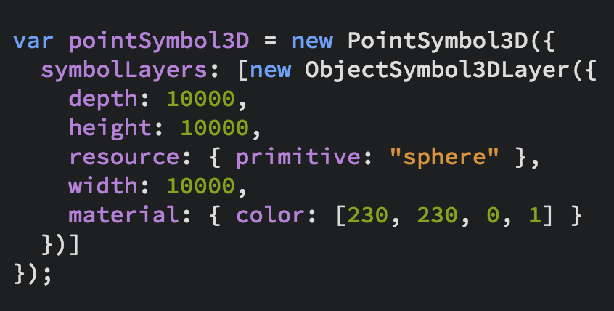
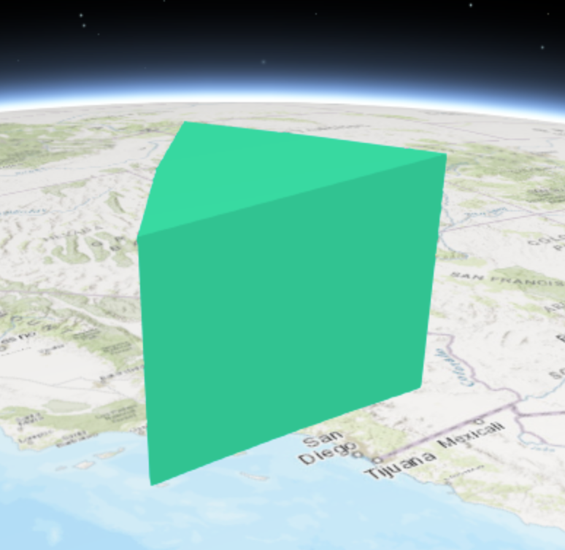
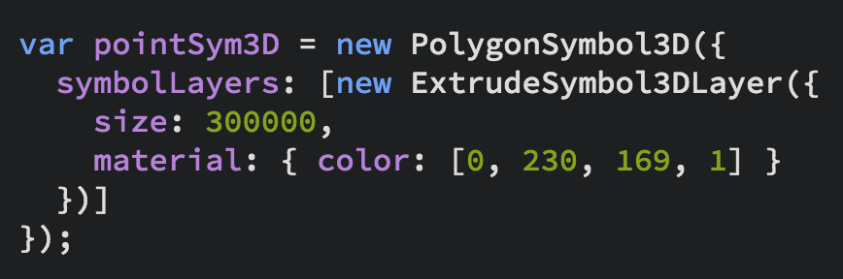
3D Symbols

Slide 10
Renderers

Slide 11
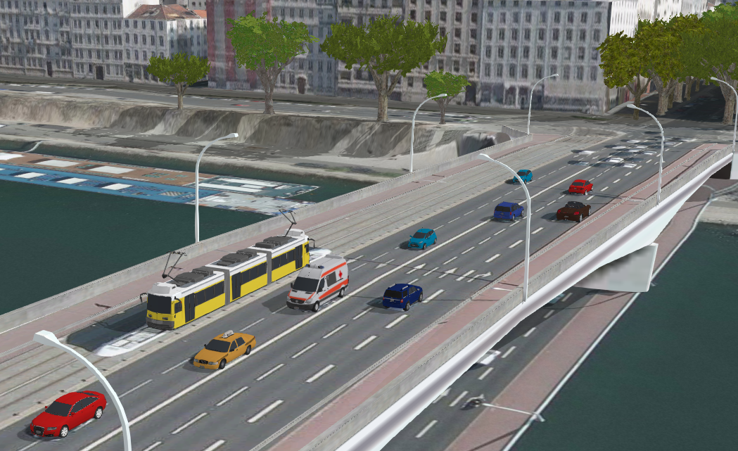
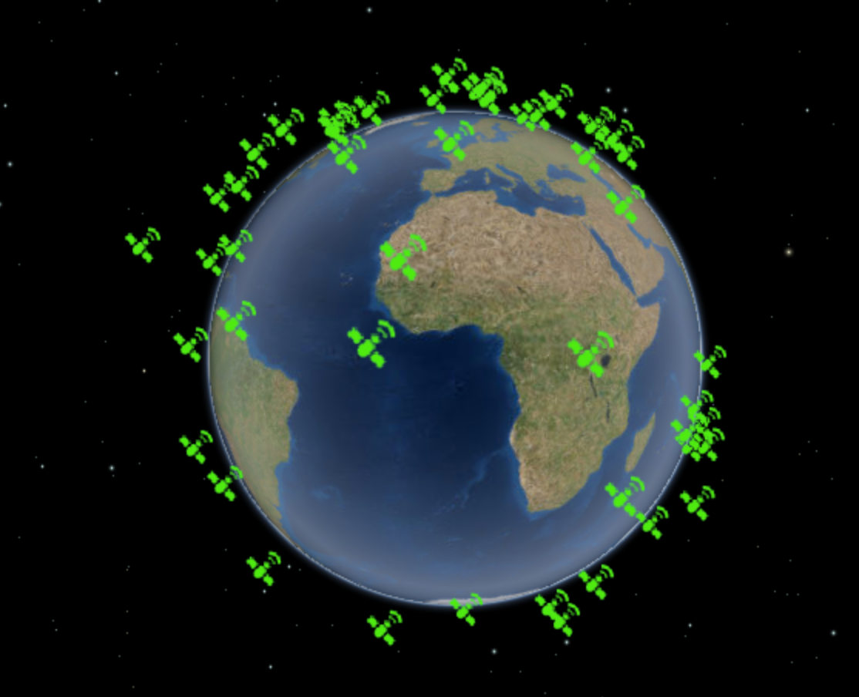
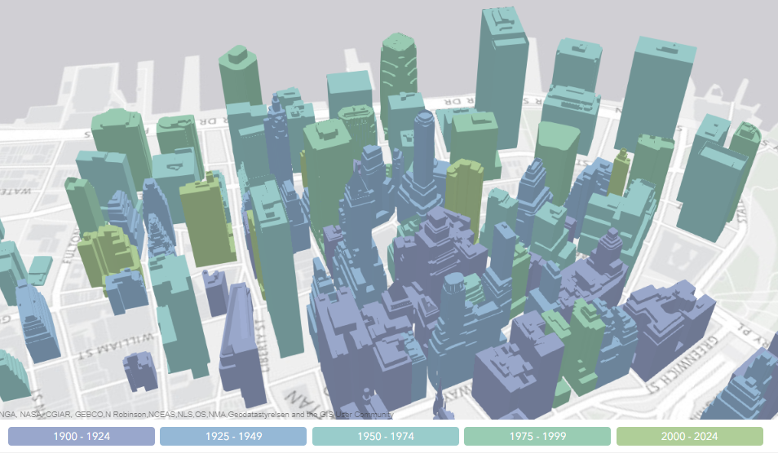
UniqueValueRenderer
Renderers
SimpleRenderer
ClassBreaksRenderer

Slide 12
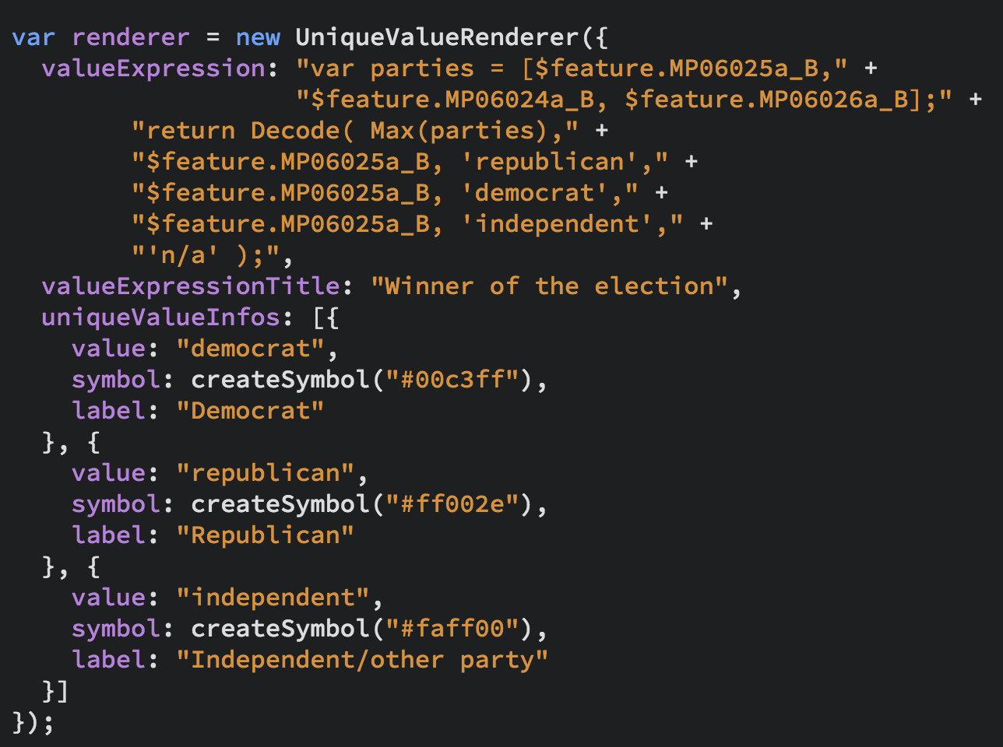
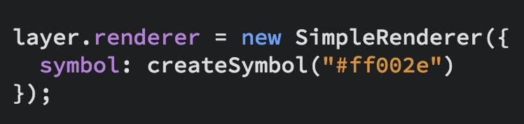
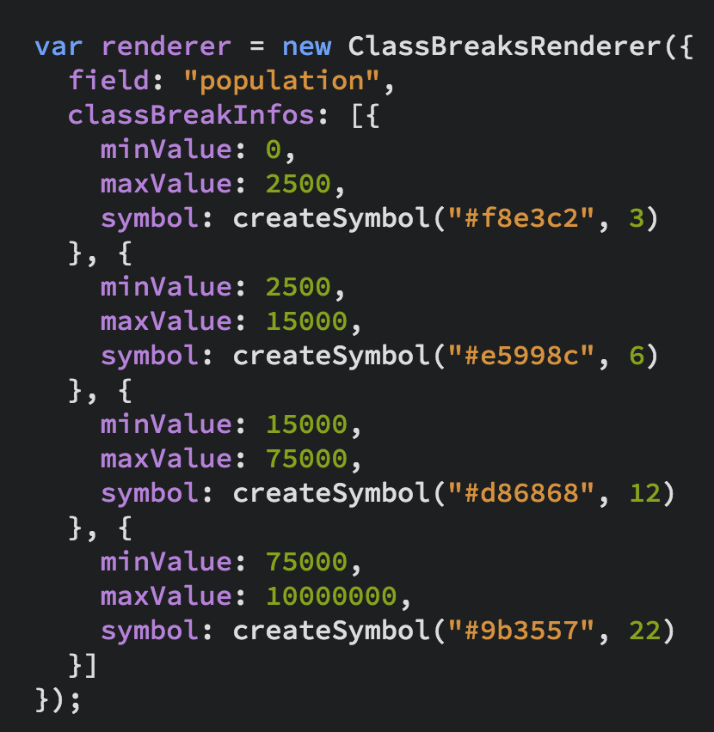
UniqueValueRenderer
Renderers
SimpleRenderer
ClassBreaksRenderer
…and PointCloud Renderers

Slide 13
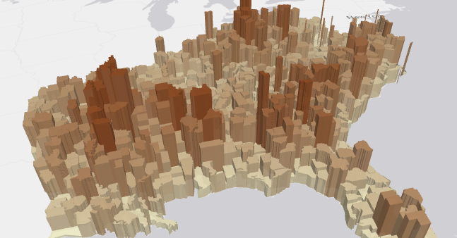
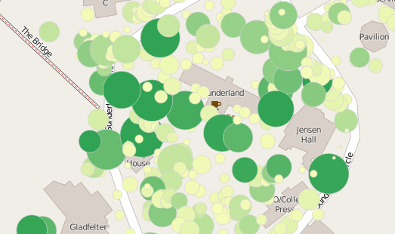
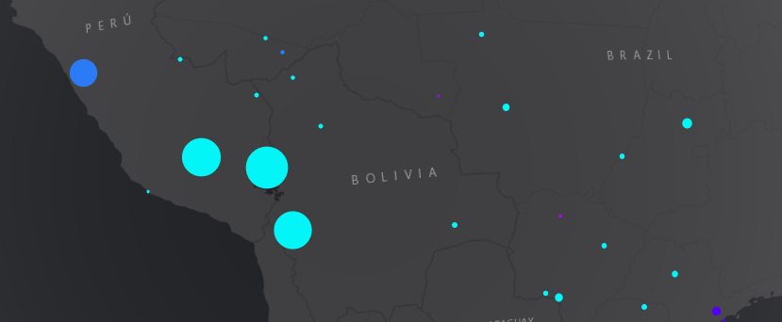
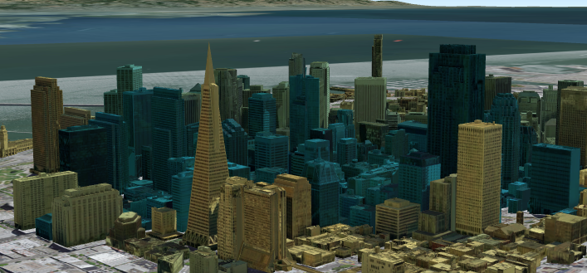
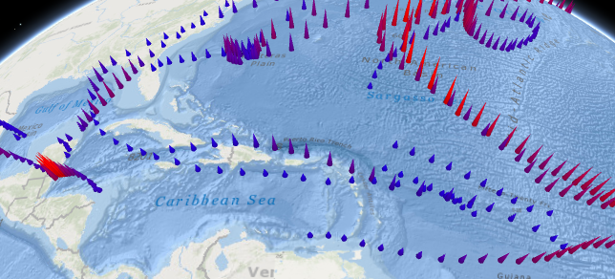
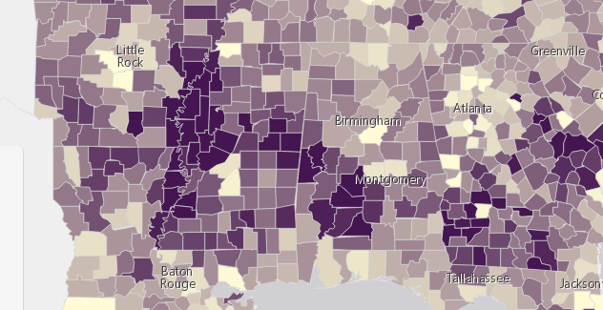
Renderers
Visual Variables
A property of the renderer
For numeric data-driven continuous visualizations
Color
Size
Height
Width
Depth
Rotation
Opacity

Slide 14
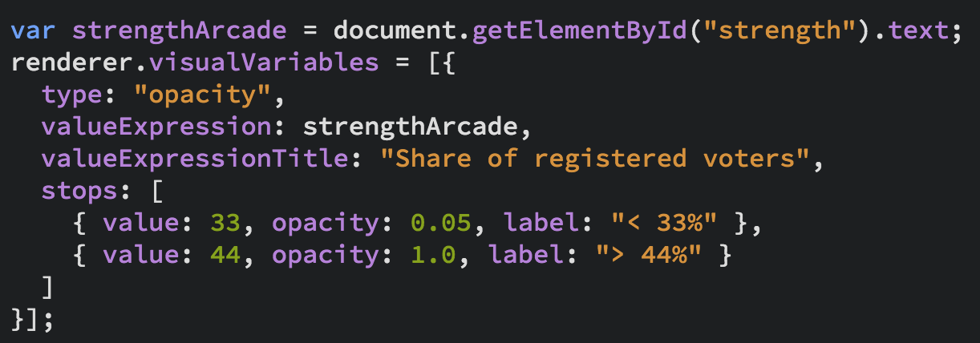
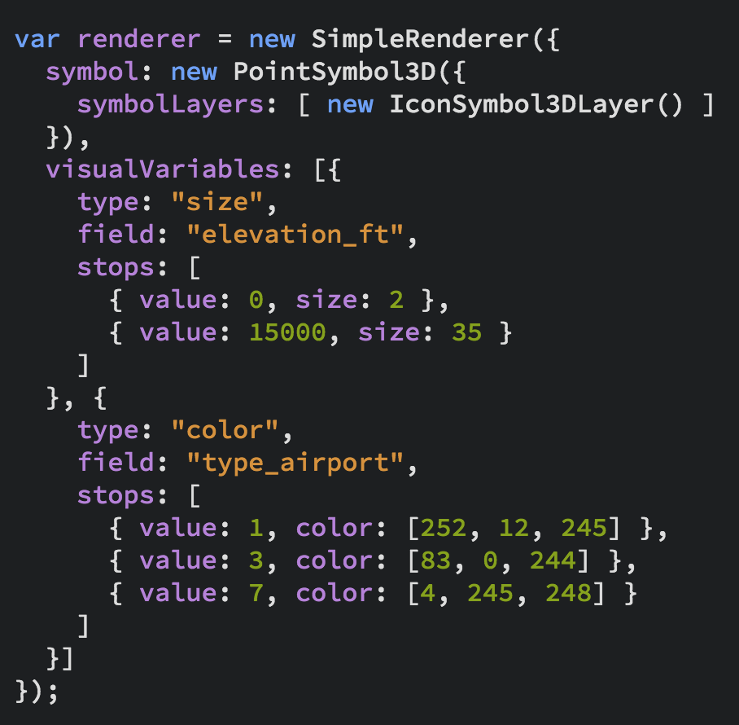
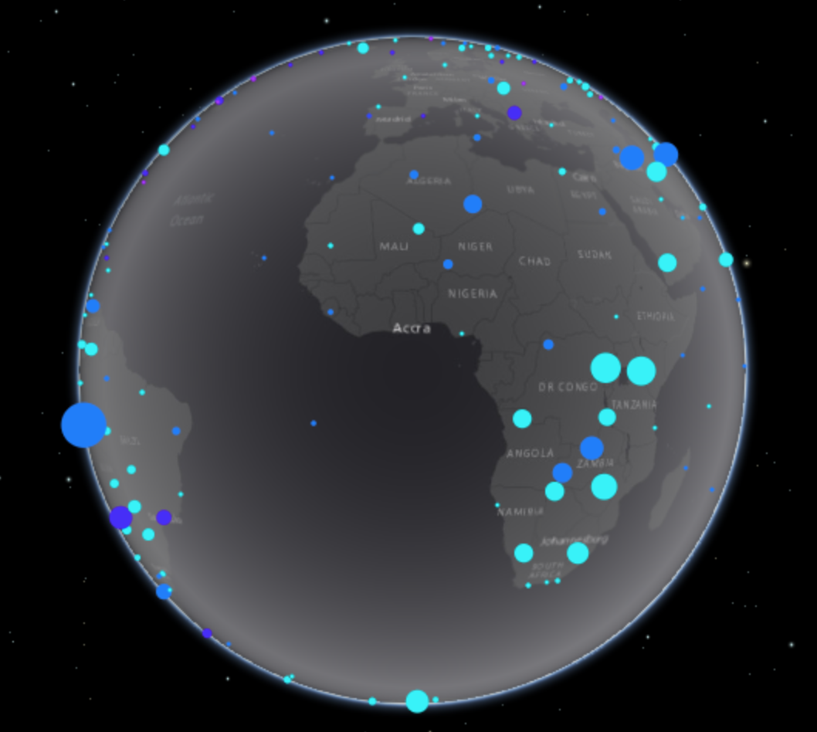
Renderers
Visual Variables

Slide 15
Examples

Slide 16

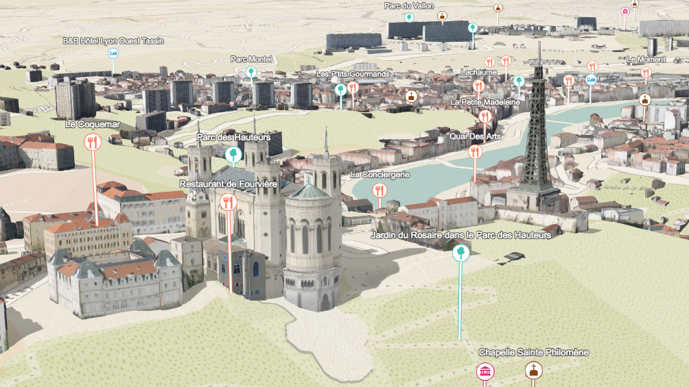
Points of interest

Slide 17
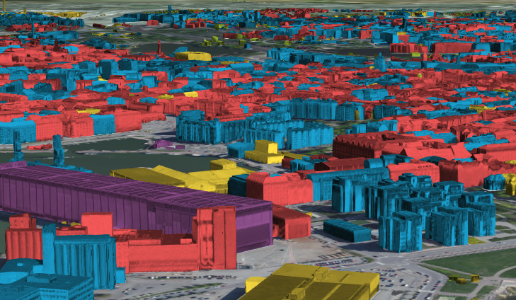
Colorized building textures

Slide 18
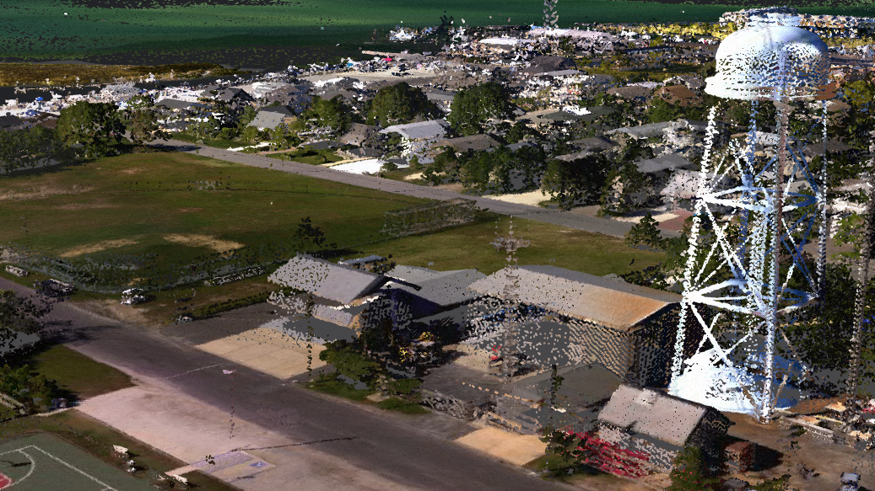
PointCloud Visualization
Renderers and more

Slide 19
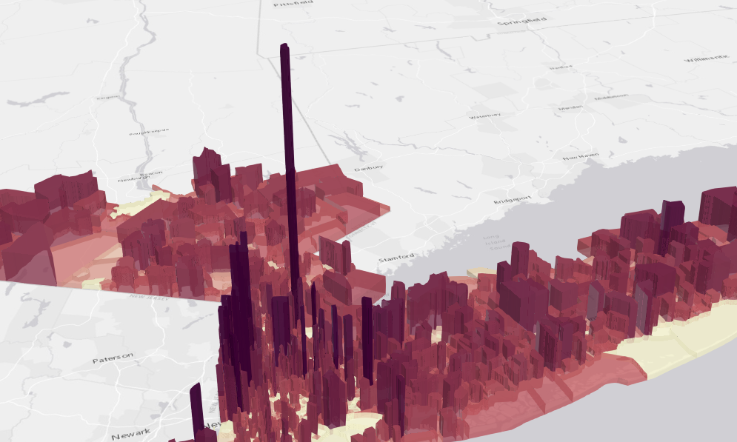
Extrusions

Slide 20
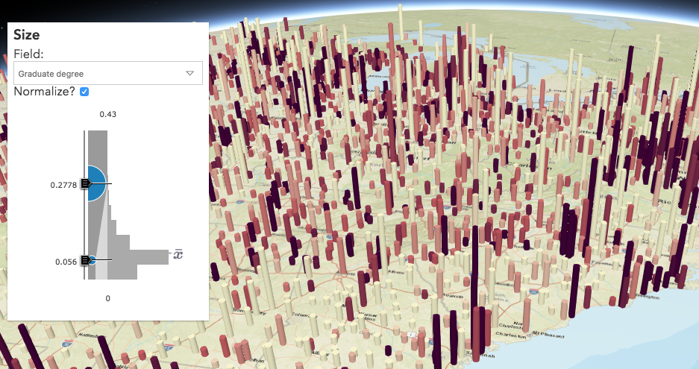
Data exploration
Smart mapping in custom apps

Slide 21
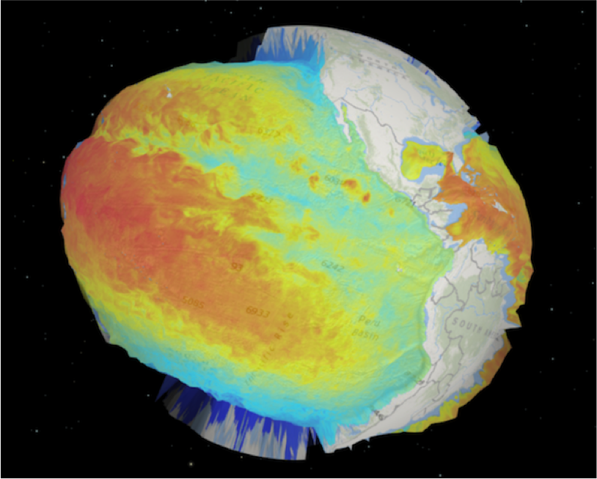
Abstract visualizations
Thematic values as elevation

Slide 22
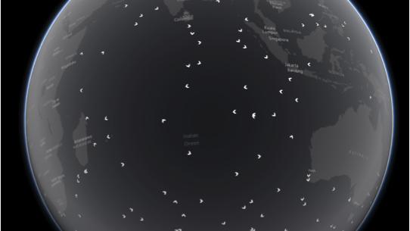
Advanced concepts
Extend underlying WebGL engine

Slide 23
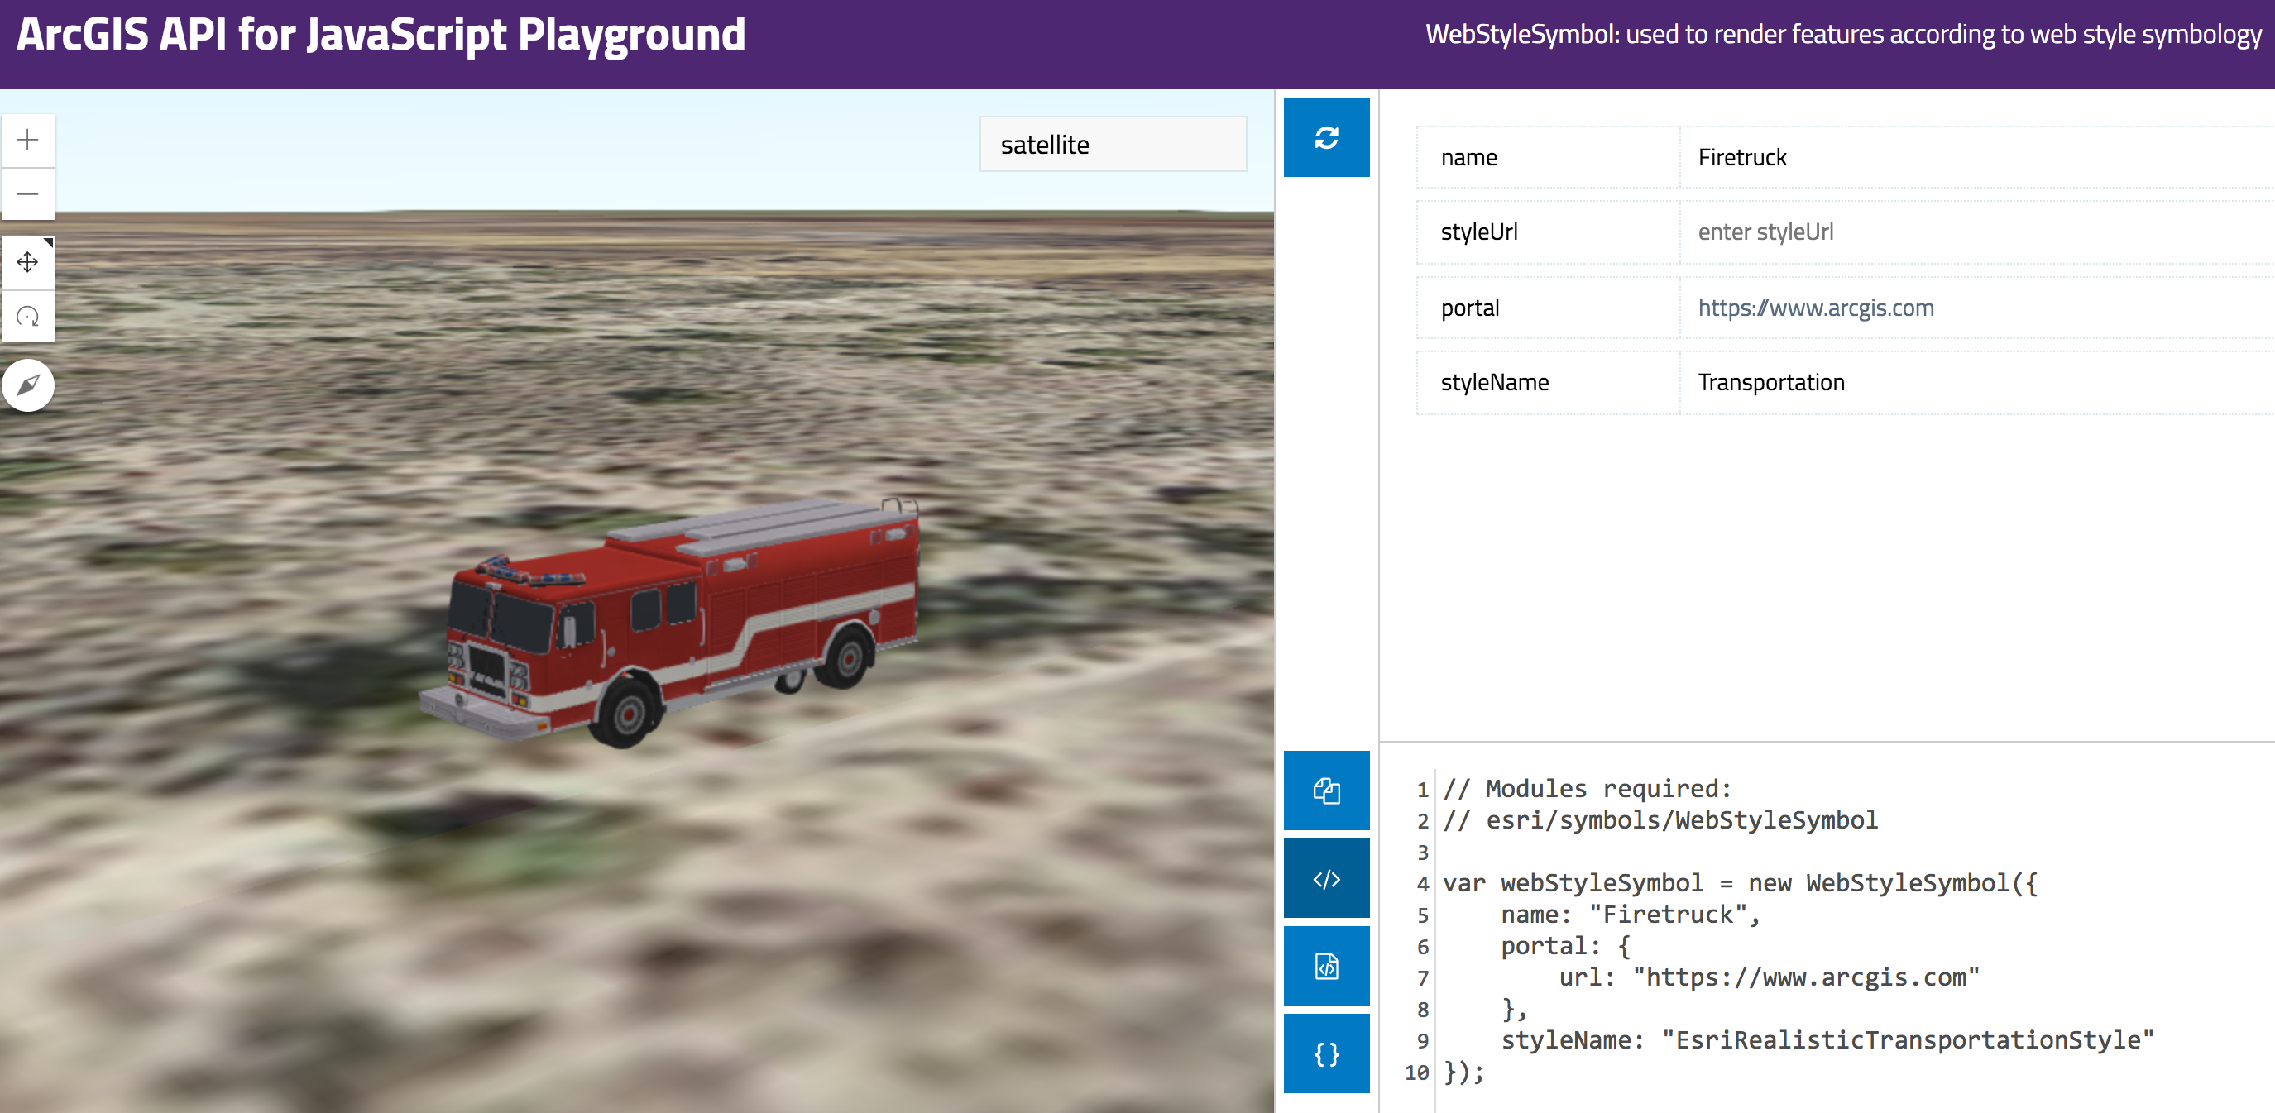
Resources
Get started with visualization
ArcGIS Blog
Icons, lines, fills
Objects, paths, extrusion
Real world sizes
Documentation
Renderer
Symbol3D
Symbol3DLayer

Slide 24



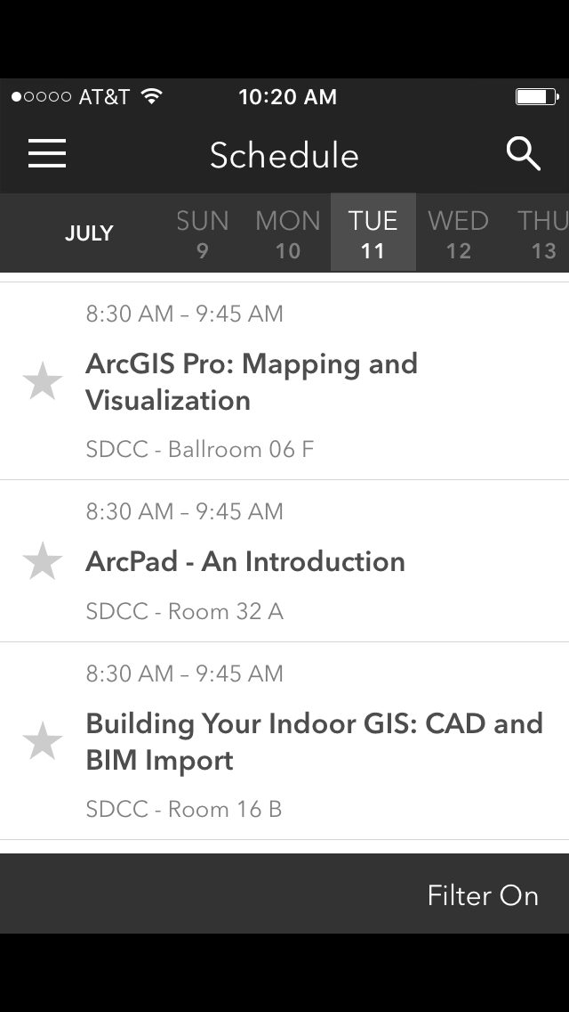
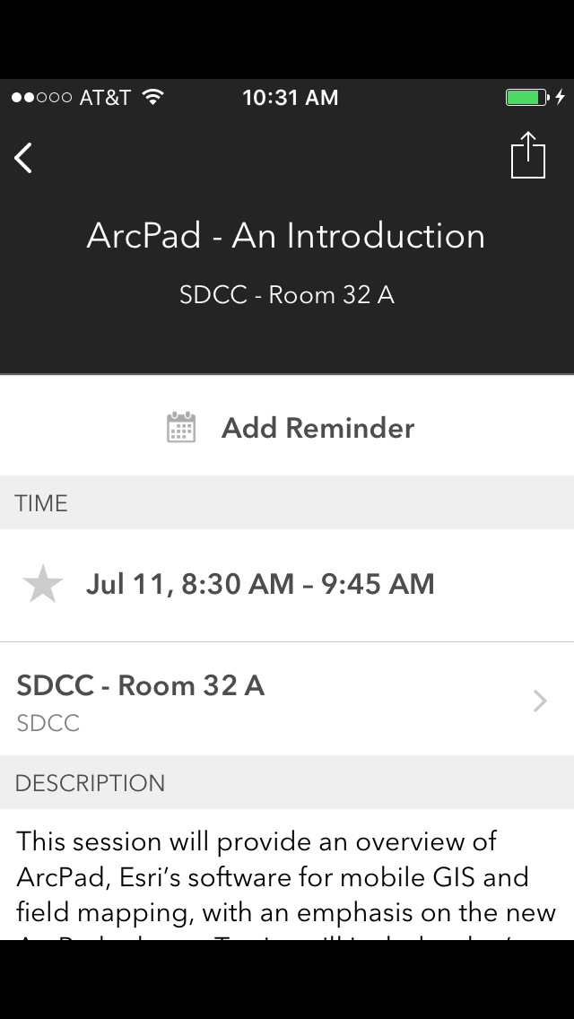
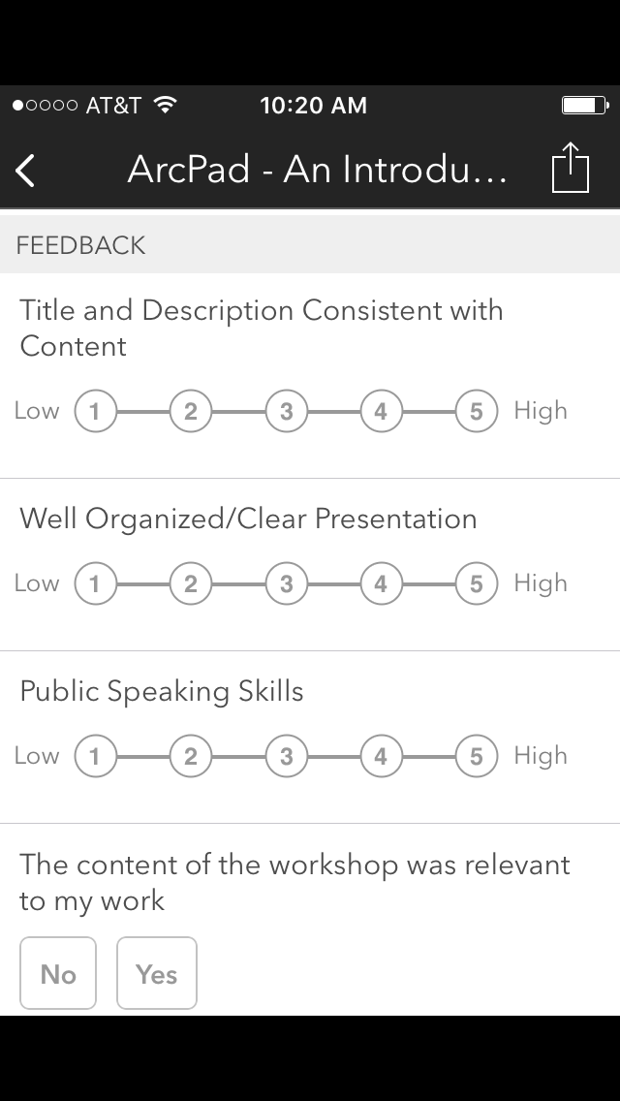

Please Take Our Survey on the Esri Events App!
Download the Esri Events app and find your event
Select the session you attended
Scroll down to find the survey
Complete Answers
and Select “Submit”

Slide 25



